Slide 1
Linear Regression Model For Imdb Dataset By Eng. Hesham Doom

Slide 2
Contents
Introduction
Analysis and project dimensions.
Results from database analysis
Machine learning Model (Linear Regression)
Conclusions

Slide 3
Introduction
As a specialized agency in business analysis, we received a request from an investor to find out the main reason for making films achieve high income. Accordingly, this study was prepared to provide the best results.Our goal to predict Revenue change compared to other features

Slide 4
Data Wrangling
Analysis and Project Dimensions
After preparing the database for the study and processing.
Some important questions were raised:
When were the highest points in which the income increased?
What are the reasons for this?Drop unnecessary columns

Slide 5
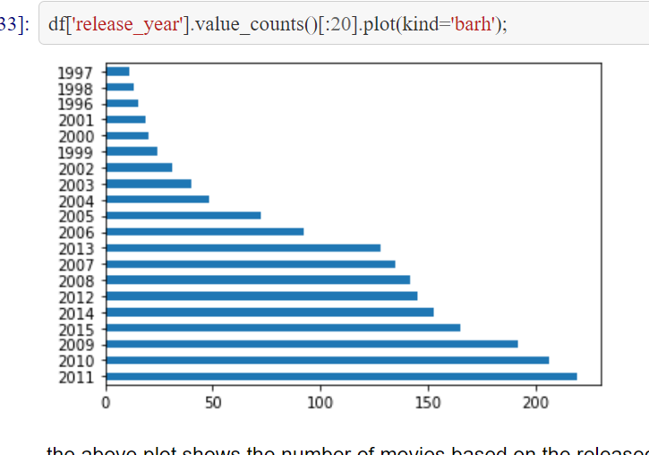
Data Wrangling
Results from database analysis
what are properties which will be associated with highly rated movie ?

Slide 6
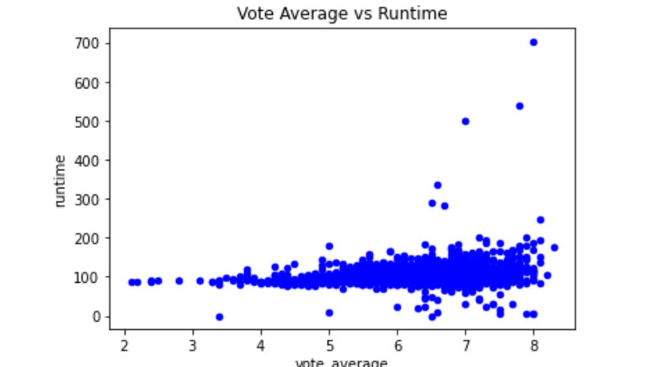
Data Wrangling
Results from database analysis
لإhis scatter plot shows us that there is a weak relation ship between vote average and runtime and it shows that the longest movie has a high vote avergae

Slide 7
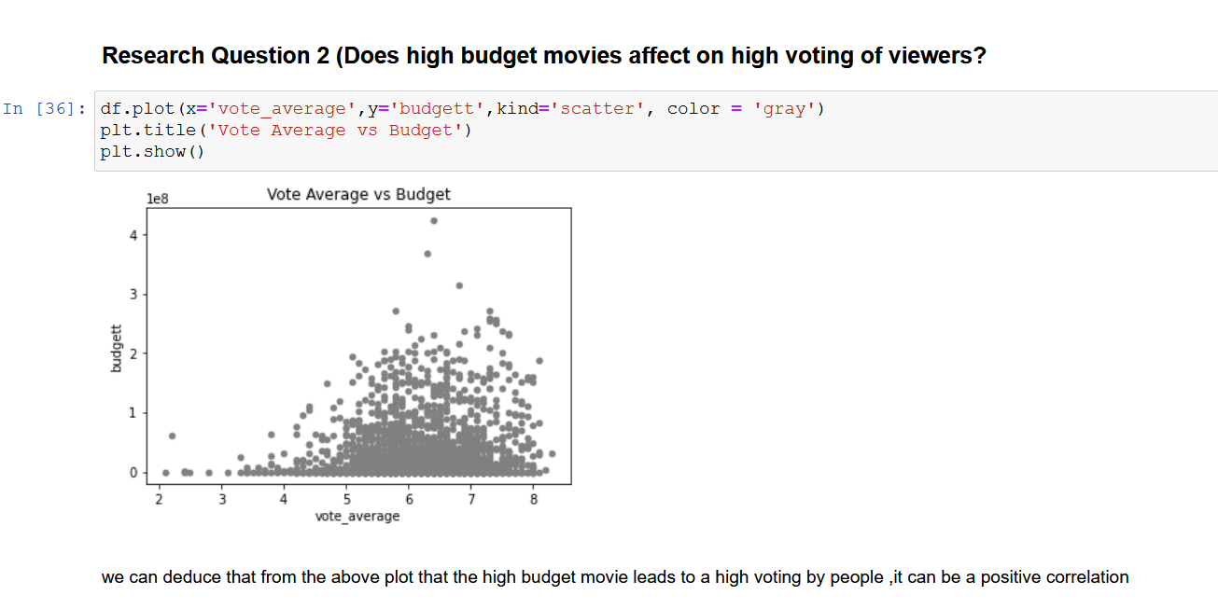
Data Wrangling
the high budget movie leads to a high voting by people

Slide 8
Machine learning Model (Linear regression)
Algorithm
linear Regression model =Testing score: 70.0 %
Decision Tree Regressor = Testing score: 80.0 %
Kneighbors Regresso = Testing score: 80.0 %

Slide 9
Conclusions
Recommendations
The revenue increase is developing with to the budget prepared to use them for the film..
Choosing the right time to release the film is essential, as it affects the number of views and income.
The popularity of the movie is linked to producing company which increases the income of the film.

Slide 10
Thank you

